Slide 1
Making space for You & Your PeerS to think mathematically
What Works?
Notes:
-As you have discovered over time, there are various ways to learn. In mathematics, one of these ways is to learn through solving problems in a collaborative manner.
-Today’s class has been structured as an interactive means of uncovering the very aspects that constitute this approach to teaching & learning mathematics.
Learning Goal:
We are learning to make ‘space’ for thinking mathematically.

Slide 2
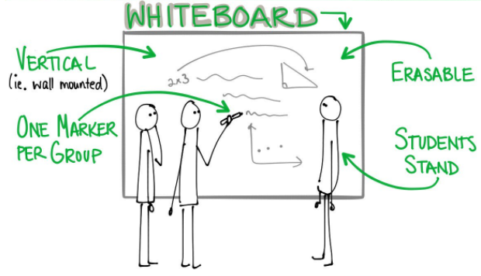
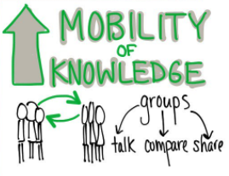
Working at VNPS
Vertical Non-Permanent Surfaces (VNPS): Whiteboards!
Last Time…
-One dry-erase marker
-recorder ‘inks’ the thinking of those who are speaking
For Today…
-Random group of 3
-Check for understanding in your group
-How will you communicate?
-Periodically, we’ll stop to share, compare & decide what’s important/meaningful
Notes:
Step 1:
Guidelines for working at vnps
-Random group of 3
-One dry-erase marker
-recorder ‘inks’ the thinking of those who are speaking
-Check for understanding
-How will you communicate?
-Stop to share, compare & decide what’s important (“We”)
-We write “I can…” statements (Success Criteria)
Step 2: Introduce task (next set of slides: 5 to 11)
[Teacher: Monitor]
-Talk (who is saying what/give concrete examples/highlight specific talk moves)
-Anticipated Talk Moves: repeat, re-voice, agree/disagree (explain), build on, connect to (all require listening…but to engage in a “talk move,” students need to be actively listening)
-Note: Students might share/explain the mathematics they are working on. Validate this, and if you have anecdotes re: the group’s discussion moves, highlight/draw attention to these. Also invite other groups to “re-voice/agree-disagree (explain), build on, connect to”
-Note: Depending upon the level of accountability to discourse, it might be good to have students repeat, re-voice
-Good assessment strategy for helping determine “Who Knows What?” and for developing accountability.
Step 3: Find a ‘place’ to show the video clip (Slide 12) re: Lucy West
-Make connections w/ the class to what ‘moves’ they’ve already engaged in/have mentioned

Slide 3
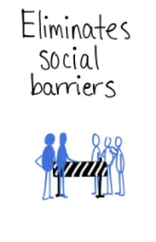
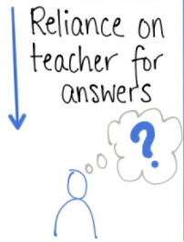
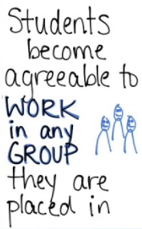
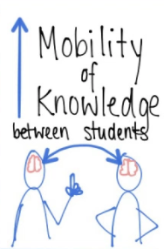
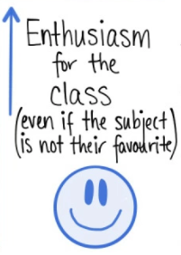
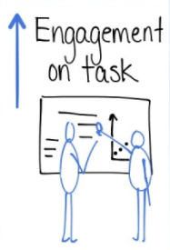
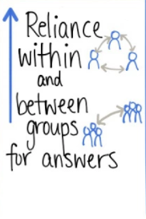
VISIBLY RANDOM GROUPS (VRGs)
Notes:
Step 1:
-Notice the strengths that were identified in your groups.
-By combining your strengths, it is possible to accomplish more than what might on your own.
-An important aspect of the work that we do today involves “visibly random groups.”
-We’ll get into these groups shortly. For now, let’s take a look at some of the benefits to this way of forming groups.
Step 2:
-Create random groups (e.g., by using playing cards)

Slide 4
PROBLEM
25
Liljedahl, P. Building Thinking Classrooms-Keynote. OAME Leadership Conference, Ottawa (Nov 10, 2017).

Slide 5
PROBLEM
25 = 12 + 13
Liljedahl, P. Building Thinking Classrooms-Keynote. OAME Leadership Conference, Ottawa (Nov 10, 2017).

Slide 6
PROBLEM
25 = 12 + 13
25 = 10 + 8 + 7
Liljedahl, P. Building Thinking Classrooms-Keynote. OAME Leadership Conference, Ottawa (Nov 10, 2017).

Slide 7
PROBLEM
25 = 12 + 13
25 = 10 + 8 + 7
25 = 10 + 10 + 5
Liljedahl, P. Building Thinking Classrooms-Keynote. OAME Leadership Conference, Ottawa (Nov 10, 2017).

Slide 8
PROBLEM
25 = 12 x 13
25 = 10 x 8 x 7
25 = 10 x 10 x 5
Liljedahl, P. Building Thinking Classrooms-Keynote. OAME Leadership Conference, Ottawa (Nov 10, 2017).

Slide 9
PROBLEM
25 = 12 x 13 = 156
25 = 10 x 8 x 7 = 560
25 = 10 x 10 x 5 = 500
Liljedahl, P. Building Thinking Classrooms-Keynote. OAME Leadership Conference, Ottawa (Nov 10, 2017).

Slide 10
PROBLEM
25 = 12 x 13 = 156
25 = 10 x 8 x 7 = 560
25 = 10 x 10 x 5 = 500
What is the biggest number you can get?
Liljedahl, P. Building Thinking Classrooms-Keynote. OAME Leadership Conference, Ottawa (Nov 10, 2017).
Notes:
[Teacher]
Some ways that students might come to producing their largest number:
-making their factors as close as possible to one another
-use of decimal fractions
-using negative numbers
-?
-?

Slide 11
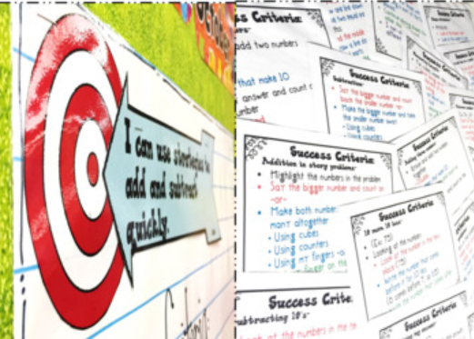
Our success criteria
Learning Goal: To make ‘space’ to think mathematically,…
We can…
…?
…?
…?
…?
Notes:
[Teacher]
Anticipated criteria borne from this learning experience (invite students to reflect upon their experience today and to help co-create criteria for success—criteria for building a supportive environment that also emphasizes the importance of discourse)
To make space for thinking mathematically, students can…
-work together in mixed/random groups
-communicate their ideas orally to one another
Step out in front/take risks to sharing their thinking
-record their thinking on whiteboards
-Use talk moves (e.g., repeat, re-voice, agree/disagree (explain), build on, connect to, ask questions)
-Ask questions to clarify
[You might choose to ask this of students and/or if students have already identified these actions for themselves, make connections to what they’ve already said]
To make space for thinking mathematically, teachers can…
-Give tasks that provide all students an opportunity to use their prior knowledge and uncover something new (encouraging risk taking, collaboration, exploration)
-Encourage students to ask questions and to listen actively to others
-Help create an environment for students to talk about mathematics
-Ask good questions to provoke students’ thinking
Other:
-On subsequent days, re-visit students’ criteria for making ‘space’ to think mathematically—i.e., re-inforce, encourage students to revise/add on/remove details from the list of shared criteria.

Slide 12
Exit card
Share your thoughts about your learning experience today.
On a stick-it note,…
Write a note to a peer describing what you learned during class today (including a ‘to’ and ‘from’).
Pass your note to your peer so they can have a chance to read your feedback.
Post your stick-it notes so that others can make connections to what was learned today.
Notes:
[Teacher]
-There are a variety of closure activities that can be done to gauge what students have learned and what interventions might be planned for moving forward.
-Some examples include: 3-2-1, So What?, Question Stems, Students I Learned From the Most (Source: Edutopia, from https://www.edutopia.org/blog/22-powerful-closure-activities-todd-finley)
-You might also choose to augment the process by using technology-enabled surveys (e.g., MS-Forms, Google Forms, other LMS-related survey/polling tools), where results can be collected in real-time, graphically organized, and re-purposed efficiently for classroom discussion

Slide 13
A few extras…
Slides 14-19
Notes:
Additional slides for lesson facilitation, Day 1, Day 2, Day 3+

Slide 14
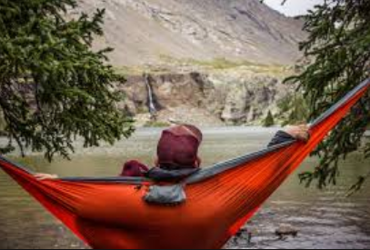
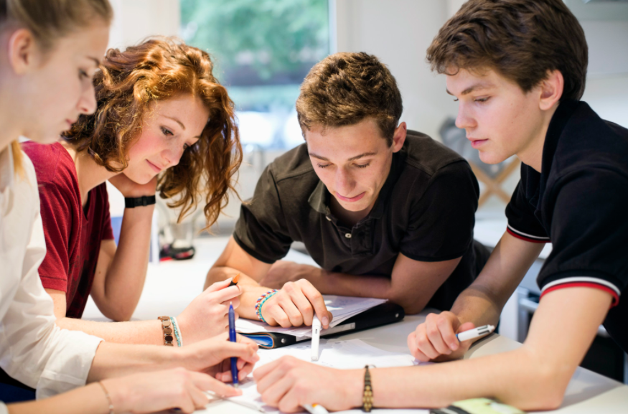
Collaboration
“The action of working with someone to produce or create something” (Oxford Living Dictionary).
Notes:
Step 1:
-Consider the images posted around the room.
-Which of these images might best represent your experience with collaboration?
-Go to this image.
Step 2:
-Discuss with the people in your group, why you chose this image.
Start as a pair, then discuss as two pairs, until the full group has had a chance to participate with one another.
Step 3:
-Share some highlights, of your discussion, with the class.
[Teacher: On a visible surface, start to highlight the strengths of the styles that students are describing.]

Slide 15
Working at VNPS
Vertical Non-Permanent Surfaces (VNPS): Whiteboards!
For Today:
-Random group of 3
-One dry-erase marker
-recorder ‘inks’ the thinking of those who are speaking
-Check for understanding
-How will you communicate?
-We stop to share, compare & decide what’s important/meaningful
-We write “I can…” statements (Success Criteria)
Notes:
Step 1:
Guidelines for working at vnps
-Random group of 3
-One dry-erase marker
-recorder ‘inks’ the thinking of those who are speaking
-Check for understanding
-How will you communicate?
-Stop to share, compare & decide what’s important (“We”)
-We write “I can…” statements (Success Criteria)
Step 2: Introduce task (next set of slides: 5 to 11)
[Teacher: Monitor]
-Talk (who is saying what/give concrete examples/highlight specific talk moves)
-Anticipated Talk Moves: repeat, re-voice, agree/disagree (explain), build on, connect to (all require listening…but to engage in a “talk move,” students need to be actively listening)
-Note: Students might share/explain the mathematics they are working on. Validate this, and if you have anecdotes re: the group’s discussion moves, highlight/draw attention to these. Also invite other groups to “re-voice/agree-disagree (explain), build on, connect to”
-Note: Depending upon the level of accountability to discourse, it might be good to have students repeat, re-voice
-Good assessment strategy for helping determine “Who Knows What?” and for developing accountability.
Step 3: Find a ‘place’ to show the video clip (Slide 12) re: Lucy West
-Make connections w/ the class to what ‘moves’ they’ve already engaged in/have mentioned

Slide 16
Student voice
Discourse: “Written or spoken communication or debate; formal discussion of a topic in speech or writing; connected series of utterances—a text or conversation” (Oxford Living Dictionary)
VIDEO: OPTION 2
Notes:
[Teacher]
Lucy West
-Student Voice
-Watch from 1:03 to 2:33
-What can we do to ensure that you’re doing more of the talking (i.e., doing more of the learning)?

Slide 17
references
Liljedahl, P. (2014). The affordances of using visibly random groups in a mathematics classroom. In Y. Li, E. Silver, & S. Li (eds.), Transforming Mathematics Instruction: Multiple Approaches and Practices. (pp. 127-144). New York, NY: Springer.
Liljedahl, P. Building Thinking Classrooms-Keynote. OAME Leadership Conference, Ottawa (Nov 10, 2017). Retrieved February12, 2018, from http://www.peterliljedahl.com/presentations
Suurtamm, C., Quigley, B., & Lazarus, J. (2015, February). What Works? (Research into Practice): Making Space for Students to Think Mathematically. Retrieved February 12, 2018, from http://www.edu.gov.on.ca/eng/literacynumeracy/inspire/research/WW_SpaceThinkMath.pdf
West, L. (2011, October 16). Retrieved February 12, 2018, from https://www.youtube.com/watch?v=5mQMBX6jiOw
Wheeler, L. (2017, November 21). Re: My #ThinkingClassroom Trio of Sketchnotes & Some Photos [Web log comment]. Retrieved February 12, 2018, from https://twitter.com/wheeler_laura/status/933121783506653184)

Slide 18
A culture of discourse
Discourse: “Written or spoken communication or debate; formal discussion of a topic in speech or writing; connected series of utterances—a text or conversation” (Oxford Living Dictionary)
VIDEO: OPTION 1
Notes:
[Teacher]
Lucy West
-Culture of Classroom Discourse (Theme: ‘Moves’ for getting to know, “Who Said What?”)
2:09 to 4:00 (repeating, re-stating by students)
Getting to know who said what
Whoever’s doing the talking is doing the learning
-What can we do to ensure that you’re doing more of the talking (i.e., doing more of the learning)?

Slide 19
Exit card
Share your thoughts about your learning experience today.
On stick-it notes, write a response to #1 and #2, then post them on the chart paper provided.
1. What is something that we did today that you think we should continue? Why?
2. What is something that we did today that you think we should revise/change? Why?
On a stick-it note,…
3. Write a note to a peer describing what you learned during class today (including a ‘to’ and ‘from’). Pass your note to your peer so they can have a chance to read your feedback. Post your stick-it notes so that others can make connections to what was learned today.
Notes:
[Teacher]
-There are a variety of closure activities that can be done to gauge what students have learned and what interventions might be planned for moving forward.
-Some examples include: 3-2-1, So What?, Question Stems, Students I Learned From the Most (Source: Edutopia, from https://www.edutopia.org/blog/22-powerful-closure-activities-todd-finley)
-You might also choose to augment the process by using technology-enabled surveys (e.g., MS-Forms, Google Forms, other LMS-related survey/polling tools), where results can be collected in real-time, graphically organized, and re-purposed efficiently for classroom discussion

